Slide 1

Project on National Data Portals in Samoa and Fiji Workshop 2 Experience sharing & SDMX/.Stat Suite tools 27-31 January 2025 Suva, Fiji
Modelling guidelines and best practices

Slide 2


Learning objectives
At the end of this session, you will be able to:
Model a statistical data table according to the SDMX framework.
Apply some main modelling best practices to your data structure.
Identify relevant software for creating SDMX data structures.

Slide 3
Outline
Quality of a data structure
Linked open data principles
Semantic interoperability
Content-oriented guidelines
Cross-domain concepts
Frequently used components
Cross-domain codelists
SDMX Global Registry
Governing SDMX artefacts
Guidelines for SDMX DSDs
Structural principles
Local/global representations
Global DSDs
Process of data modelling
Identify statistical concepts
Assign roles to concepts
Define data types/codelists
Compose the DSD
Define the dataflow(s)
Decomposing indicators
Decomposing UoMs
Software for creating DSDs
Exercise: Create a DSD
Conclusions
Discussion and Q&A

Slide 4
Quality of a data structure
What makes the quality of a data structure ?

Slide 5
Quality of a data structure
How can you make a terrible dataset?
Typos in observed values
Wrong data
Incomplete data
Inconsisten data
Different formats
Not updated
Duplicates
Missing values
Wrong coding
Wrong labelling
Missing attributes
No unit measures
Missing dimension
Not machine
Duplication
Inaccesibility
Missing explanations
Time series are very short

Slide 6
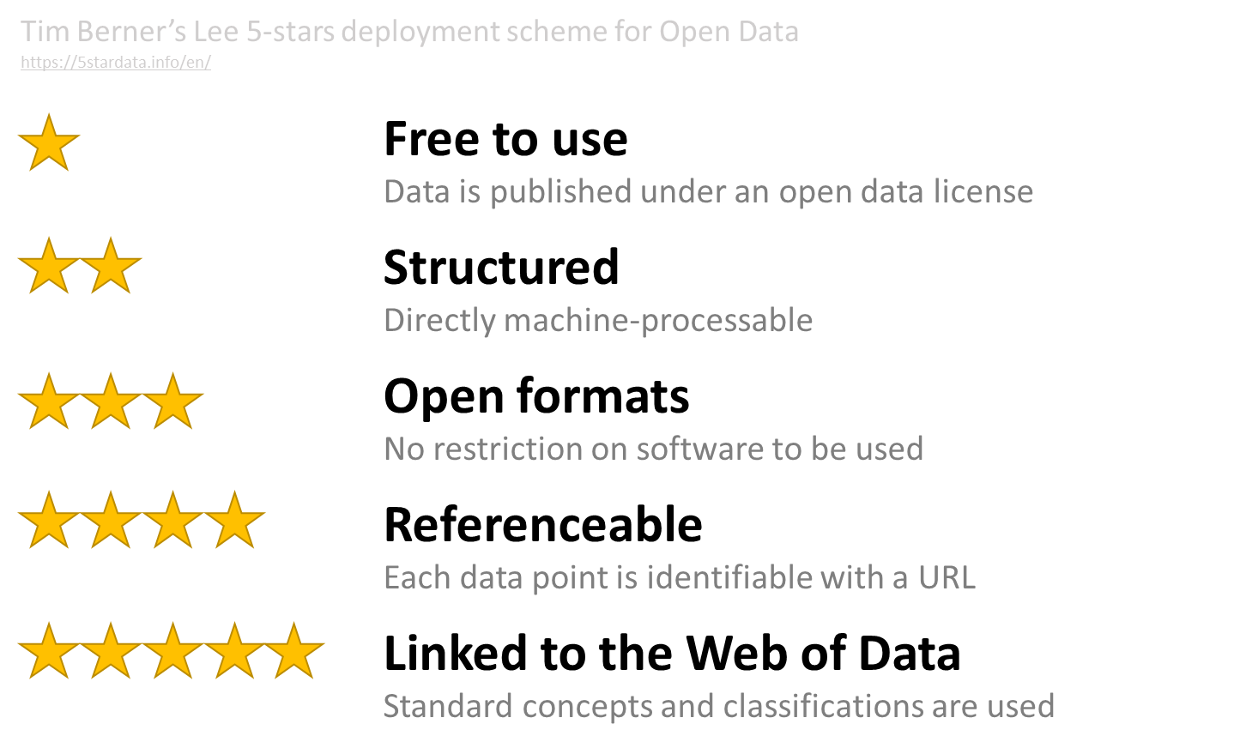
Linked open data principles

Slide 7
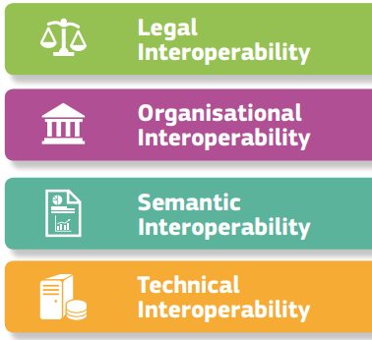
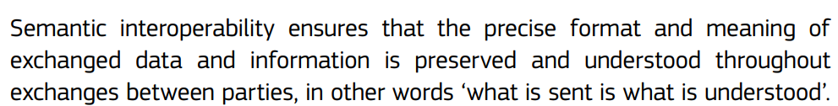
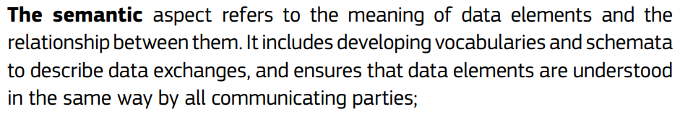
Semantic interoperability
European Interoperability Framework (EIF)
https://ec.europa.eu/isa2/sites/default/files/eif_brochure_final.pdf
The SDMX community provides an ever-growing library of standardised codes, labels and definitions in controlled vocabularies that are designed for reuse.
Reusing controlled vocabularies can help people understand the data having used the terms before, lead to easier machine-processing of the data in avoiding silo-based systems that understand coding for only one agency or domain, and, vastly reduce the amount of mapping required between agencies and systems.
.STAT Academy, https://academy.siscc.org/

Slide 8
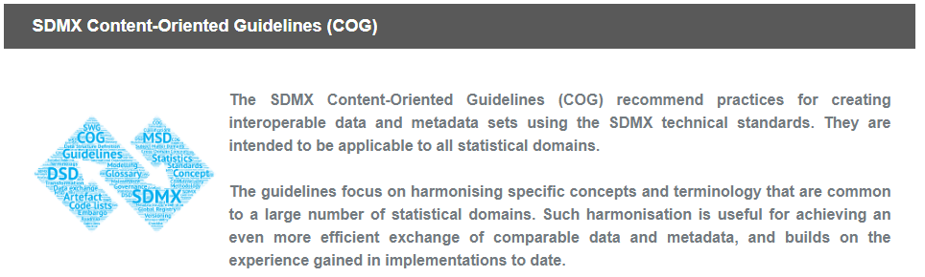
Content-oriented guidelines
Cross-domain concepts
Cross-domain codelists
Statistical subject-matter domains
Glossary
Guidelines on governance of SDMX artefacts
Reference Framework for SDMX Structural Metadata Governance
Governance of commonly used SDMX metadata artefacts
Other Guidelines
Guidelines on using SDMX Annotations
Standardising Reference Metadata Reporting in SDMX
Modelling Statistical Domains in SDMX
Guidelines for representing methodological changes in DSDs
Guidelines for SDMX Data Structure Definitions
Guidelines for the Creation and Management of SDMX Code Lists
Guidelines on the Versioning of SDMX Artefacts
Guidelines on Non-Calendar Year Reporting of Data
Possible Ways of Implementing the Observation Status Concept
Guidelines for Confidentiality and Embargo in SDMX
Guidelines on coding time transformations in SDMX
Guidelines for SDMX Concept Roles
Checklist for SDMX Data Providers
SDMX Global Registry Content Policy
https://sdmx.org/?page_id=4345

Slide 9
Cross-domain concepts
Cross-domain concepts in SDMX describe concepts relevant to many, if not all, statistical domains. SDMX recommends using these concepts whenever feasible in SDMX structures and messages to promote the reuse and exchange of statistical information and related metadata between organisations.
The SDMX Glossary contains concepts and related definitions used in structural and reference metadata of international organisations and national data-producing agencies. It recommends using a common terminology to facilitate communication and understanding. The overall message of the SDMX Glossary is: if a term is used, then its precise meaning should correspond to the Glossary definition.
https://ec.europa.eu/eurostat/web/sdmx-infospace/sdmx-explained/what-and-why/content-oriented-guidelines
SDMX cross-domain concepts are available in Word, HTML or as an SDMX concept scheme in the SDMX registry:
https://sdmx.org/wp-content/uploads/SDMX_Glossary_version_2_1-Final-2.docx
https://sdmx.org/wp-content/uploads/SDMX_Glossary_Version_2_1_December_2020.htm
https://registry.sdmx.org/sdmx/v2/structure/conceptscheme/SDMX/CROSS_DOMAIN_CONCEPTS/2.0

Slide 10
Frequently used components
Frequency (FREQ)
Time period (TIME_PERIOD): Timespan or point in time to which the observation refers.
Reference area (REF_AREA): Country or geographic area to which the measured statistical phenomenon relates.
Observation value (OBS_VALUE): The field which holds the data.
Several orthogonal characteristics that can be combined to make up the unit information in dataflows.
Unit of measure (UNIT_MEASURE): The unit in which the data values are expressed.
Unit multiplier (UNIT_MULT): The exponent in base 10 used for calculating the actual value in the unit of measure.
Base period (BASE_PER): Period used as the base of an index number, or to which a constant series refers.
Time transformation (TRANSFORMATION): Time-related operation performed on a time series, solely involving observations of that time series.
Observation status (OBS_STATUS): Information on the quality of a value or an unusual or missing value.
Observation comment (OBS_COMMENT)

Slide 11
Cross-domain codelists
Cross-domain code lists are officially adopted by the SDMX Secretariat based on proposals from the Statistical Working Group (SWG).
These codelists are generally made available in Word or Excel formats and can also be downloaded in SDMX-ML format from the SDMX Global Registry:
https://registry.sdmx.org/overview.html

Slide 12
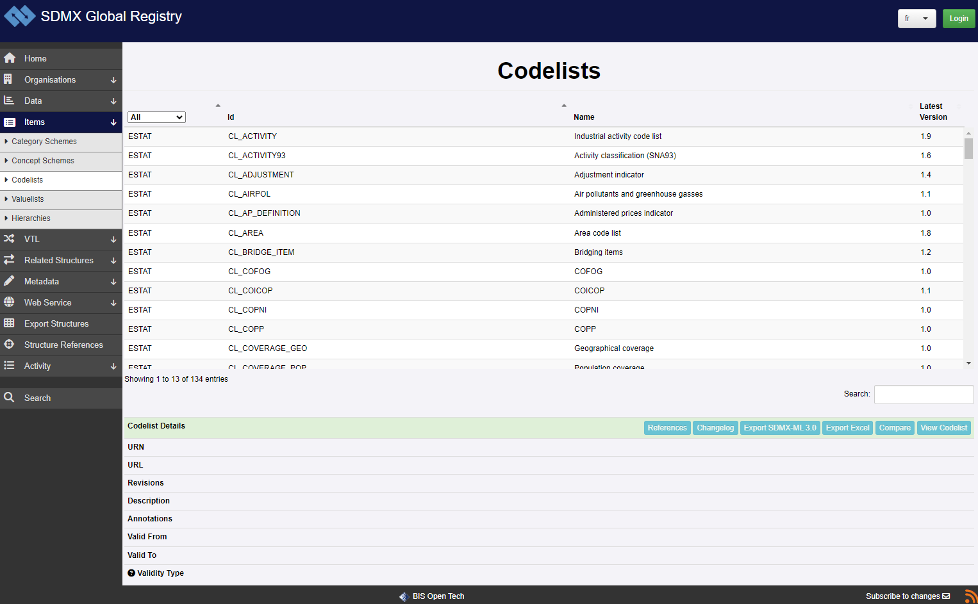
SDMX Global Registry
https://registry.sdmx.org/

Slide 13
Exercise
Find the standard cross-domain codelist for unit multipliers in the SDMX Global Registry.

Slide 14
Governing SDMX artefacts
Maintaining agency is a part of the identifier of SDMX artefacts, a hierarchy of agency schemes defines codes associated to organisations and organisational units responsible for SDMX content.
For more details see the “Reference Framework for SDMX Structural Metadata Governance”, part of SDMX content-oriented guidelines.
https://sdmx.org/wp-content/uploads/SDMX-Structural-Metadata-Governance.docx
SDMX artefacts can be marked as final to indicate users and systems that they will not change and that their systems and queries will continue to work. Only names or annotations may change if an artefact is marked as final.
Semantic versioning: 3-parts version numbers as minor.major.patch.

Slide 15
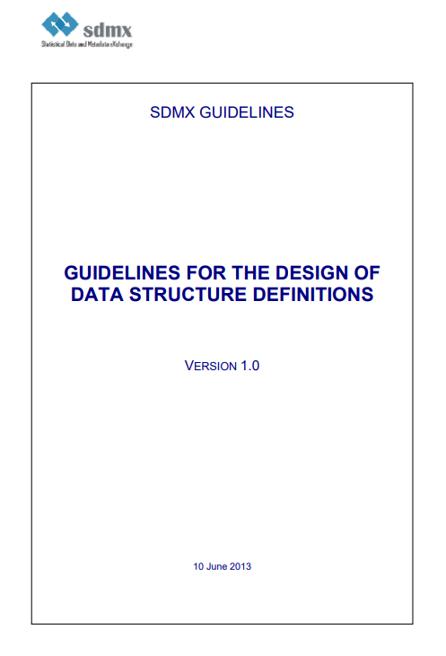
Guidelines for SDMX DSDs
https://sdmx.org/wp-content/uploads/SDMX_Guidelines_for_DSDs_1.0.pdf
Provides guidelines, principles and recommendations for the adoption of the SDMX standard for data collection, exchange, and dissemination based conceptual considerations and first-hand experiences with global DSD development by sponsors organisations.
Takes into account the specific requirements of different usage contexts such as different types of data, different data exchange scenarios and different types of intended recipients.

Slide 16
Structural principles

Slide 17
Local/global representations
Concepts used is DSDs can have a global (default) representation defined in the concept scheme, or a local representation defined at the level of the DSD.
(using the “CoreRepresentation” and “LocalRepresentation” tags in XML files)
Representations can be codelists or datatypes (Double, String, ObservationalTimePeriod, …)
Setting default representations to concepts, f.i. assigning common codelists to common concepts may be a way of harmonising data structures in an SDMX database.

Slide 18
Global DSDs
SDMX Global Data Structure Definitions (DSDs) are standard reporting frameworks that have been agreed by the SDMX sponsors as the preferred method for their constituent members to exchange statistics.
The global DSDs are designed and maintained by subject-matter and SDMX experts from at least 3 sponsor organisations.
They are stored in the SDMX Global Registry.
Main global DSDs:
National Accounts
Balance of Payments
Harmonised Trade IMTS
Labour Statistics
Foreign Direct Investment (FDI)
Education
Sustainable Development Goals (SDGs)
System of Environmental Economic Accounts (SEEA)
Some other data structures used by international agencies are not global DSDs strictly speaking but are very widely used worldwide such as the IMF “ECOFIN” data structure.

Slide 19
Process of data modelling
Identify statistical concepts
Assign roles to concepts
Define data types and codelists
Bundle components into a DSD
Define the dataflow(s)

Slide 20
Identify statistical concepts
Identify all concepts used in the dataset.
List breakdowns available for indicators, these may be explicit as distinct columns or be collapsed into single columns, in particular in indicator labels, or mentioned in dataset titles (may be relevant if multiple tables are grouped together as part of the modelling activity).
Decompose the information as much possible.
Link to existing concepts as much as possible, from cross-domain concepts, standard or corporate vocabularies, previous projects, ….

Slide 21
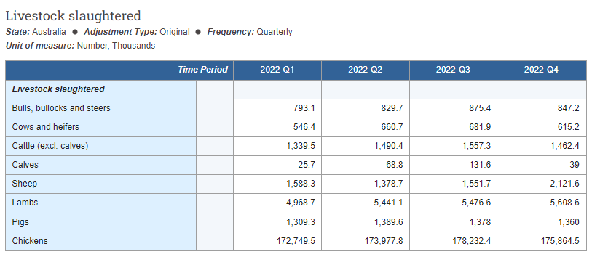
Identify statistical concepts
https://explore.data.abs.gov.au/vis?fs[0]=Industries%2C0%7CAgriculture%23AGRICULTURE%23&pg=0&fc=Industries&df[ds]=INDUSTRY_TOPICS&df[id]=LSTOCK_SLAUGHT&df[ag]=ABS&df[vs]=1.0.0&pd=2022-Q1%2C2022-Q4&dq=.AUS.10.Q

Slide 22
Identify statistical concepts
https://explore.data.abs.gov.au/vis?fs[0]=Industries%2C0%7CAgriculture%23AGRICULTURE%23&pg=0&fc=Industries&df[ds]=INDUSTRY_TOPICS&df[id]=LSTOCK_SLAUGHT&df[ag]=ABS&df[vs]=1.0.0&pd=2022-Q1%2C2022-Q4&dq=.AUS.10.Q
GEO
ADJUSTMENT
FREQUENCY
UNIT
MULTIPLIER
TIME
LIVESTOCK
VALUE

Slide 23
Assign roles to concepts
Identify concepts used to identify observations, they will play the role of dimension in the DSD.
If there are serval indicators in the tables, see if one or several dimensions need to be added to distinguish them.
If a dimension concept has the same value for the whole table, remove it from the data structure and include the value in the dataflow name.
Include a measure called “observation value”.
Identify concepts that do not identify observations but add contextual information to support interpretation of the data, they will play the role of attribute.

Slide 24

Assign roles to concepts
https://explore.data.abs.gov.au/vis?fs[0]=Industries%2C0%7CAgriculture%23AGRICULTURE%23&pg=0&fc=Industries&df[ds]=INDUSTRY_TOPICS&df[id]=LSTOCK_SLAUGHT&df[ag]=ABS&df[vs]=1.0.0&pd=2022-Q1%2C2022-Q4&dq=.AUS.10.Q
GEO
ADJUSTMENT
FREQUENCY
UNIT
MULTIPLIER
TIME
LIVESTOCK
VALUE

Slide 25
Assign roles to concepts
https://explore.data.abs.gov.au/vis?fs[0]=Industries%2C0%7CAgriculture%23AGRICULTURE%23&pg=0&fc=Industries&df[ds]=INDUSTRY_TOPICS&df[id]=LSTOCK_SLAUGHT&df[ag]=ABS&df[vs]=1.0.0&pd=2022-Q1%2C2022-Q4&dq=.AUS.10.Q
DIMENSION
DIMENSION
DIMENSION
ATTRIBUTE
ATTRIBUTE
DIMENSION
DIMENSION
MEASURE

Slide 26
Define data types/codelists
For each data structure components (dimension, measure, attribute), assign a representation.
Re-use existing codelists as much as possible, from cross-domain codelists, standard or corporate codelists, previous projects, …
If an existing codelist can’t be re-used, create a new one, specifying codes, names, labels, orders and hierarchy.
Re-use standard statistical classifications when possible.
Include standard generic SDMX codes such _T (total) or _Z (non-applicable), if necessary.
If representation is non-coded select an appropriate datatype.
Define if attributes are mandatory or conditionnal.

Slide 27
Define data types/codelists
https://explore.data.abs.gov.au/vis?fs[0]=Industries%2C0%7CAgriculture%23AGRICULTURE%23&pg=0&fc=Industries&df[ds]=INDUSTRY_TOPICS&df[id]=LSTOCK_SLAUGHT&df[ag]=ABS&df[vs]=1.0.0&pd=2022-Q1%2C2022-Q4&dq=.AUS.10.Q
DIMENSION
DIMENSION
DIMENSION
ATTRIBUTE
ATTRIBUTE
DIMENSION
DIMENSION
MEASURE
27

Slide 28
Define data types/codelists
https://explore.data.abs.gov.au/vis?fs[0]=Industries%2C0%7CAgriculture%23AGRICULTURE%23&pg=0&fc=Industries&df[ds]=INDUSTRY_TOPICS&df[id]=LSTOCK_SLAUGHT&df[ag]=ABS&df[vs]=1.0.0&pd=2022-Q1%2C2022-Q4&dq=.AUS.10.Q
CODED
CODED
CODED
CODED
CODED
TIME
CODED
NUMERIC

Slide 29
Compose the DSD
Consolidate the list of components, associated concepts and representations (codelists of datatypes).
Set the order of dimensions.
Define attachment level of attributes.

Slide 30
Compose the DSD

Slide 31
Define the dataflow(s)
Set the name and description of the dataflow.
Define possible content constraints.
Associate possible thematic categorisation.
If relevant include presentation metadata for defining default table view (filters, layout, …).
If multiple dataflows are created to offer different views on the same data, identify for each of them the subset of dimensions or codelists that is relevant, and create corresponding content constraints.

Slide 32
Define the dataflow(s)

Slide 33
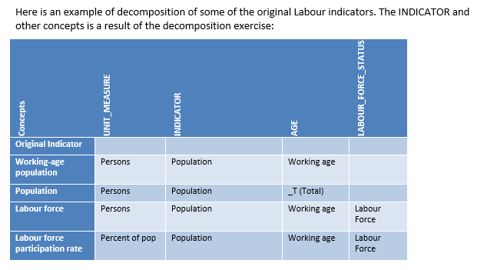
Decomposing indicators
Example from SDMX Guidelines on MODELLING STATISTICAL DOMAINS IN SDMX, Version 2.0 of 27/6/2018

Slide 34
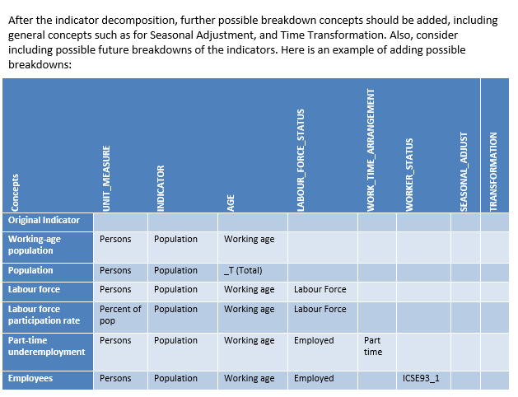
Decomposing indicators
Example from SDMX Guidelines on MODELLING STATISTICAL DOMAINS IN SDMX, Version 2.0 of 27/6/2018

Slide 35
Decomposing UoMs
Similarly units of measures can sometimes be decomposed.
Units of measure decomposition refers to the process of breaking down a complex unit of measurement into its fundamental components, such as the base unit, multiplier, and any relevant adjustment factors, allowing for a more granular understanding and comparison of data across different contexts.

Slide 36
Software for creating DSDs
Fusion Metadata Registry (FMR) Workbench
https://www.sdmx.io/fmr/
Developed by the BIS as part of its Open Tech platform, structural metadata registry for SDMX allowing to author and maintain SDMX structures.
SDMX Matrix Generator
https://gitlab.com/sis-cc/sdmx-tools/sdmx-matrix-generator
Developed by OECD, embeds a rigorous process for designing an SDMX DSD, see accompanying .Stat Academy course “An Introduction to SDMX Structural Modelling for Data Producers to learn how to model data with the SDMX Matrix Generator”.
https://academy.siscc.org/courses/an-introduction-to-sdmx-structural-modelling-for-data-producers/

Slide 37
Exercise: Create a DSD

Slide 38
Conclusions
Quality of data modelling is important for data re-use, linking and interoperability.
Common concepts and codelists should be used when possible.
Modelling principles such as parsimony, simplicity and purity can be used as a guide.
When possible indicators and units of measures should be decomposed into their constituent concepts.

Slide 39
Discussion and Q&A giuliodr@spc.int

